Slide 1



What is immigration?
Immigration is the movement of people from
one country or region to another in order to
make a new home.

Slide 2

What is an immigrant?
An immigrant is a person who moves from
one country or region to another in order to
make a new home.
Picture from: http://www.hmongstudies.org/HmongCulturalCenterESLProgramPhotos05.html

Slide 3


Why do people move?
People immigrate because of push factors or
pull factors.

Slide 4
What are pull factors?
Pull factors are things that pull people to
move to a new area.

Slide 5
Ads from the past
In the past ads were placed in newspapers
and magazines urging people (trying to talk
them into) moving to a new place. On
the next few slides you will see examples of
these ads. As you look through them think
about how the ad is trying to “pull” people to
move.

Slide 6

Ad #1
This ad from 1890 says, “Canada, 160 acres of free land for every settler”
How is this ad trying to pull people to Canada?
Ad From: http://www.cic.gc.ca/english/department/legacy/chap-2.html

Slide 7
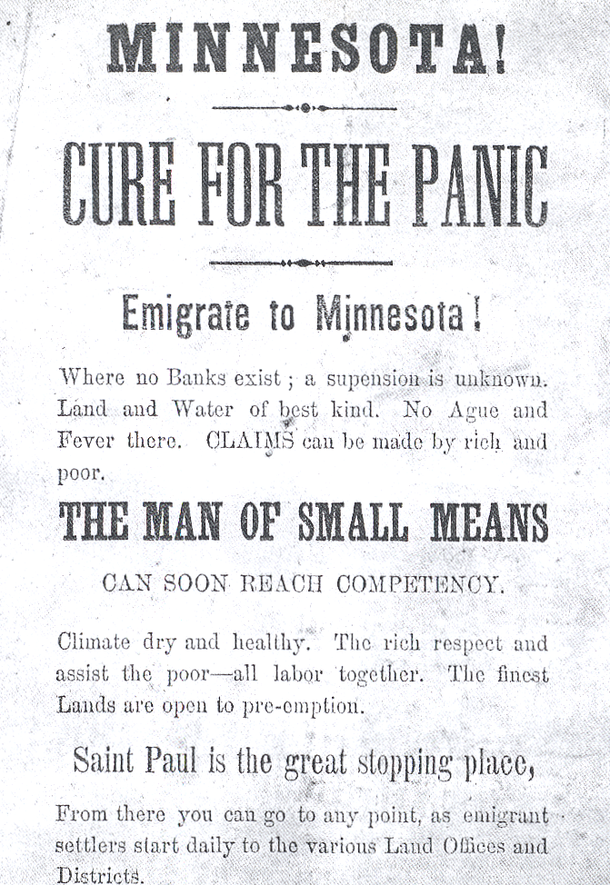
Ad #2
How is this ad trying to pull people to Minnesota?

Slide 8
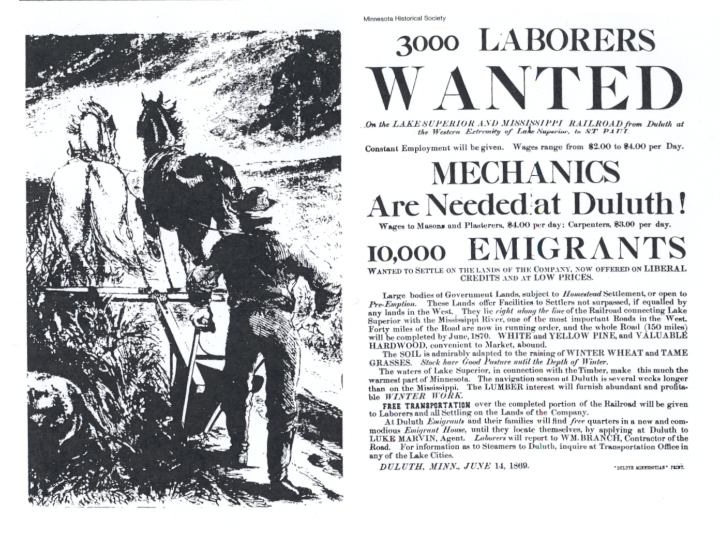
Ad #3
How is this ad trying to pull people to Minnesota?

Slide 9
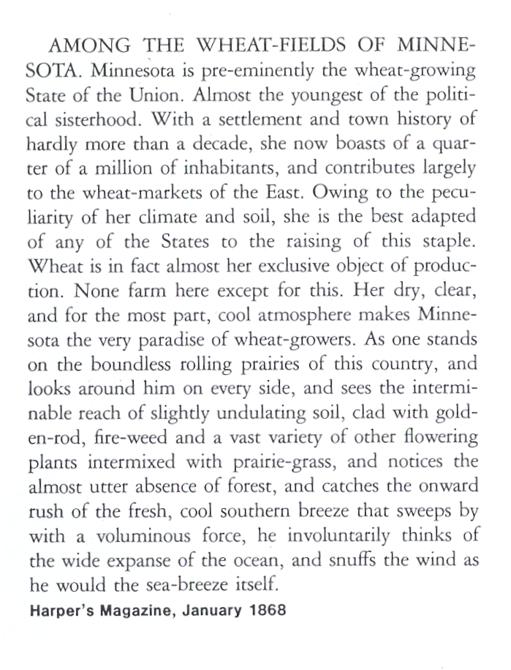
Ad #4
This article about Minnesota appeared in Harper’s Magazine in January 1868. What are the things described in this article that may pull people to Minnesota?

Slide 10
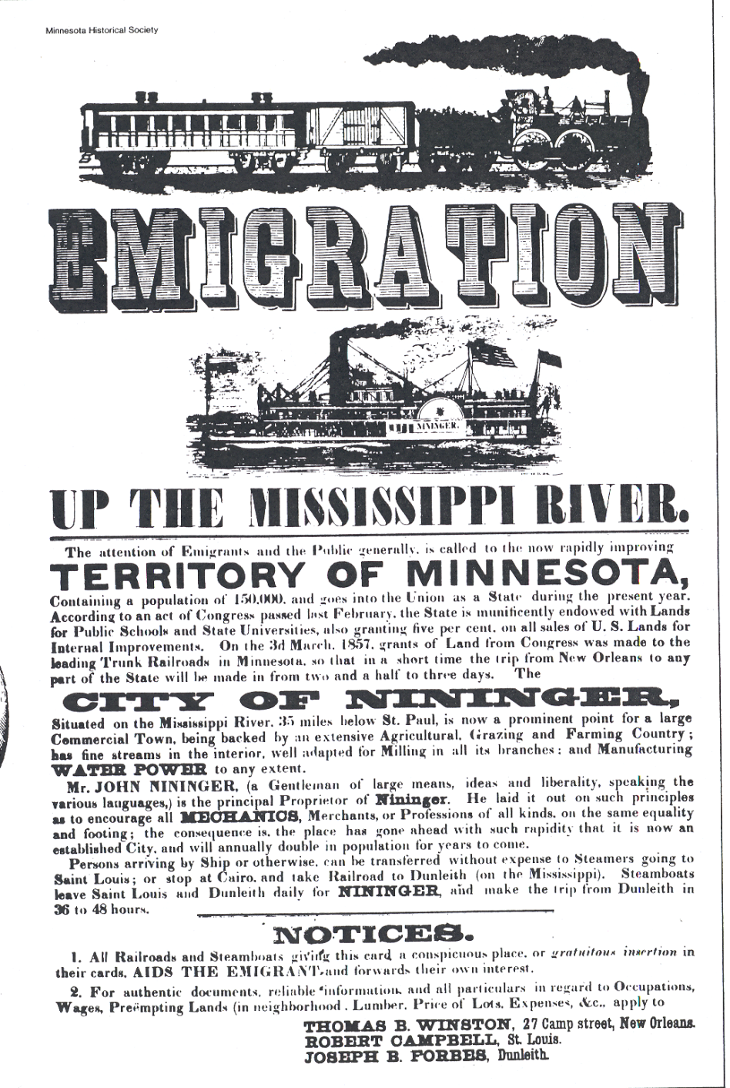
Ad #5
This ad talks about the rapidly improving territory of Minnesota? How is this ad trying to pull people to Minnesota?

Slide 11

Ad #6
How is this ad trying to pull people to Canada?
Ad from: http://www.saskschools.ca/~lyndale/canweb.html

Slide 12

Ad #7
How is this ad trying to pull people to Canada?
Ad from: http://www.pc.gc.ca/lhn-nhs/mb/forks/natcul/immigration_e.asp

Slide 13
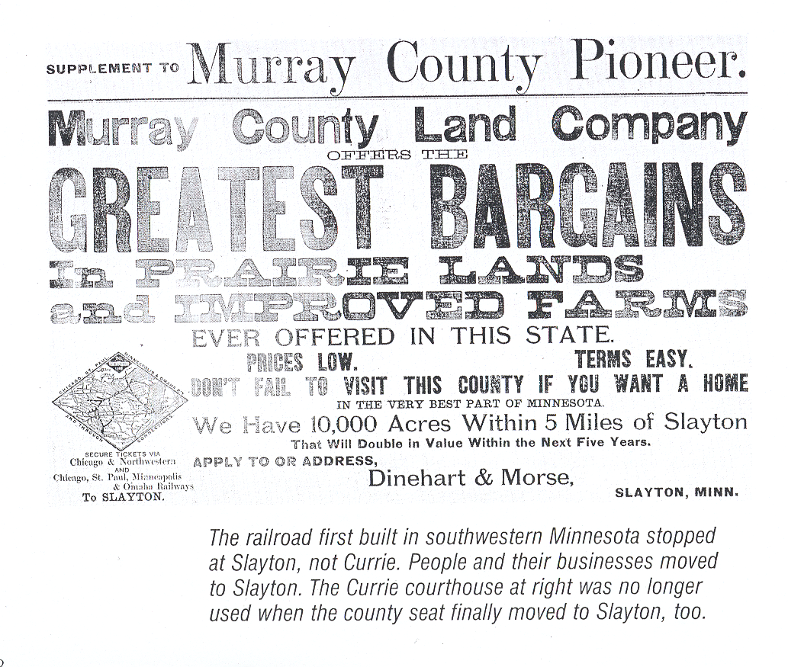
Ad #8
How is this ad trying to pull people to come to Murray County?

Slide 14
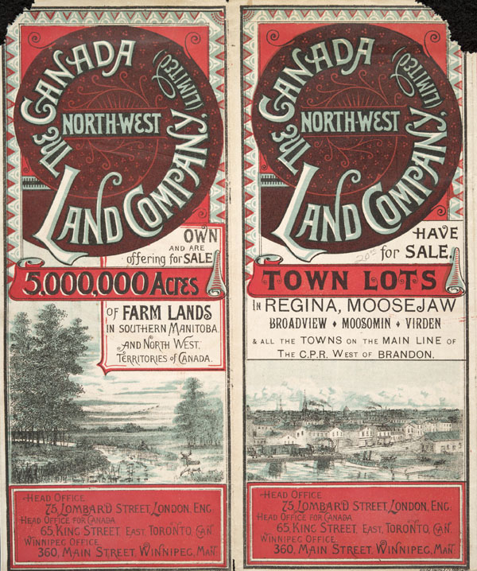
Ad #9
How is this ad trying to pull people to come to the United States?
Ad from: www.collectionscanada.ca/.../ f1/nlc003079-v6.jpg

Slide 15
What are push factors?
Push factors are things that push
people to leave.

Slide 16
Story #1
What is pushing Li’s family to leave China?
My father came to the United States in 1912 to search for a better life. There were no
jobs in our small village of Goon Do Hung in southern China. My father needed money to
take care of his new family and his widowed mother. When he first arrived in the United
States, he did any kind of job he could get. After a while, he became an apprentice in a
friend's herbal store.
Father came home once or twice that I could remember. He could never stay long because
he had to go back to the United States to work. He never mentioned that someday that he
wanted to take us to the United States, but he was thinking about it.
On his last visit home, he was sad at how poor the villagers were. They made a living by
planting rice crops. People were so poor that no one had milk to drink or had much meat to
eat. Almost no one had ever learned to read or write. So my father decided that his family
must immigrate to the United States to have a better life.
When we decided to leave, it was 1933. I was only seven years old.
From Li Keng Wong published at http://www.scholastic.com

Slide 17
Story #2
What is pushing Seymour’s family to leave Poland?
My name is Seymour Rechtzeit and I was born in Lódz, Poland, in 1912. My family is Jewish, and
I first began singing in our temple. By the time I was four, I was called wunderkind, or wonder
child in English. Soon I was singing in concerts all over Poland.
My family decided that I should come to America, where there would be more opportunities for
me. World War I had just ended, and it was a bad time in Europe. I had an uncle in America, and
he sent two tickets for my father and me. The rest of my family stayed in Poland. The plan was
that my father and I would make enough money to bring them to America, too.
In Danzig, now known as "Gdansk," we boarded a ship called The Lapland. It was 1920, and I was
on my way to America.
From Seymour Rechtzeit published at http://www.scholastic.com

Slide 18
Immigration to Minnesota
1860-1920
In 1900 a census was taken and it was determined that 2/3 of Minnesota’s
immigrants came from Germany, Sweden, and Norway
Go to this site, think about what factors are pushing the immigrants to leave
their homeland and come to Minnesota
http://www.mnsu.edu/emuseum/history/mnstatehistory/mn_migration.html

Slide 19
Here are some of the things that have pushed people to leave their homes in the past
Who When Number Why
Irish 1840s-1850s About 1.5 Million Potato crop failure and famine
Germans 1840s-1880s About 4 Million Economic depression,
unemployment and political instability
Danes, 1870s-1900s About 1.5 Million Poverty and shortage of farmland
Norwegians,
and Swedes
Poles 1880s-1920s About 1 Million Poverty, political repression, and a cholera epidemic
Jews from 1880s-1920s About 2.5 Million Religious persecution
Eastern Europe
Austrians, 1880s-1920s About 4 Million Poverty and overpopulation
Czechs,
Hungarians, and
Slovaks
Italians 1880s-1920s About 4.5 Million Poverty and overpopulation
Mexicans 1910-1920s About 700,000 Mexican Revolution in 1920;
low wages and unemployment
Source: World Book Encyclopedia

Slide 20
This is a poem written by a man that is going to leave Ireland. What are some of the factors pushing the author and his family to leave Ireland? What is pulling them to America?
Farewell to the land of Shielah and Shamrock,
Where many a long day in pleasure I spent,
Farewell to my friends whom I leave here behind me,
To live in poor Ireland if they are content;
Though sorry am I to leave the Green Island,
Whose cause I supported both in peace and war,
To live here in bondage I ne'er can be happy,
The green fields of America are sweeter by far...
I remember the time when our country did flourish,
When tradesmen of all kinds had both work and pay
But our trade all has vanished across the Atlantic,
And we, boys, must follow to America.
No longer I'll stay in this land of taxation,
No cruel task-monster shall rule over me;
To the sweet land of liberty, I'll bid good morrow,
In the green fields of America we will be free.
Poem continued on next slide

Slide 21
Poem Continued
Oh! who could stay here in want and vexation,
To hear their poor children crying out for bread,
Any many poor creatures without habitation,
And without a shelter to cover their head;
Come pack up your store and consider no longer,
Six dollars a week is no very bad pay,
No taxes or tithes will devour up your labour,
When you're in the green fields of America.
Farewell to the shores of the sweet county Antrim,
Likewise to the girls of the county Down,
May they still be as happy as ever I wished them.
Though far, far away o're the ocean I'm bound;
If ever it happens in a foreign climate,
A poor friendless Irishman comes in my way
To the best I can give, I will make him right welcome,
At my home in the green fields of America.
"Green Fields of America" - Emigration Ballad - writer unknown from http://www.erintownship.com/memorylane/mem_immigrant.html%00

Slide 22
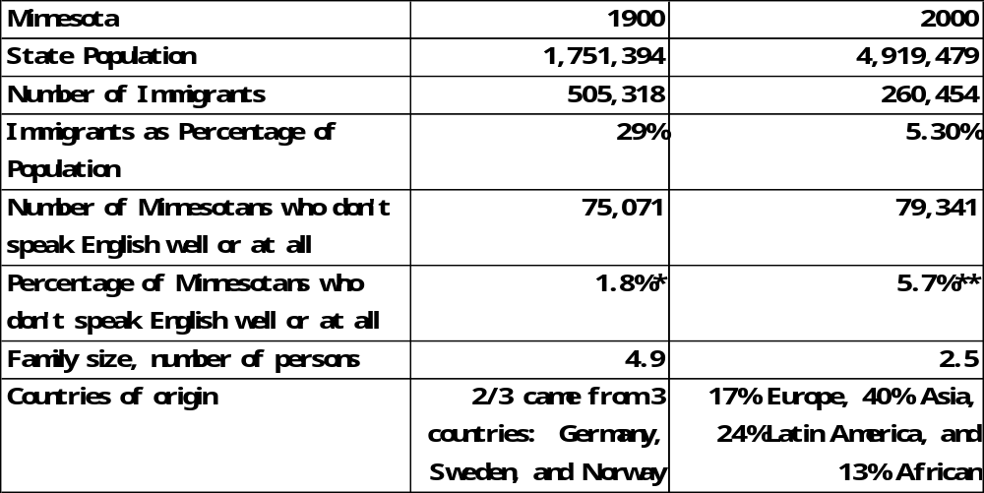
Immigrant Populations 1900 vs. 2000
Source of data: Turn of the Century: Minnesota’s Population in 1900 and Today Minnesota Planning, 1999

Slide 23
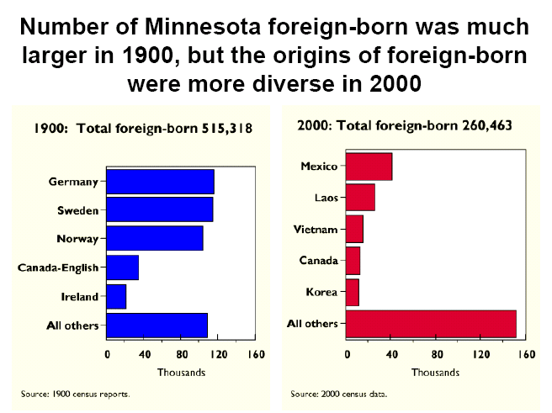
Source: Turn of the Century: Minnesota's Population in 1900 and 2000 Martha McMurry Minnesota State Demographic Center http://www.demography.state.mn.us/DownloadFiles/Presentations/CenturyPPT.pdf

Slide 24
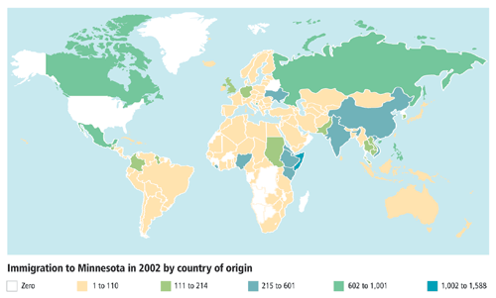
Current Immigration to Minnesota
Source: http://www.mplsfoundation.org/immigration/overview.htm

Slide 25
Go to this site
http://www.mplsfoundation.org/immigration/overview.htm

